Slide 1
Lecture 6b Empirical Analysis

Slide 2
Recall: Two Approaches to Analysis
Empirical (a posteriori) Analysis
Program the algorithms and try on a computer for different instances
Theoretical (a priori) Analysis
Determining mathematically the quantity of resources needed for each algorithm as a function of the size of the instances considered

Slide 3
Empirical Analysis
Can be also used to check experimentally the results of the theoretical analysis

Slide 4
First Approach
t_{n} = cn t_{n} = Θ(n)
t_{2n} = c.2n = 2.cn = 2.t_{n}
t_{n} = cn² t_{n} = Θ(n²)
t_{2n} = c.(2n)² = 4.cn² = 4.t_{n}
t_{n} = cn³ t_{n} = Θ(n³)
t_{2n} = c.(2n)³ = 8.cn³ = 8.t_{n}

Slide 5
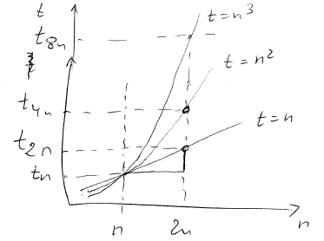

Slide 6
First Approach
t_{n} = c.log(n) t_{n} = Θ(log(n))
t_{2n} = c.log(2n) = c.(log(2)+log(n)) =
= c.log(n)+c.log(2) = t_{n} + c’
t_{4n} = c.log(4n) = c.(log(2)+log(2n)) =
= c.log(2n)+c.log(2) = t_{2n} + c’

Slide 7
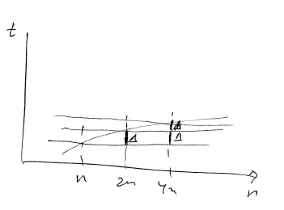
t(n)=clog(n)

Slide 8
First Approach
t_{n} = c.n.log(n) t_{n} = Θ(nlog(n))
t_{2n} = slightly more than 2t_{n}

Slide 9
Example
t₁₀₀₀ = 5 μs
t₄₀₀₀ = x μs
a) if t_{n} = Θ(n)
b) if t_{n} = Θ(n²)
c) if t_{n} = Θ(n³)

Slide 10
Example
t₁₀₀₀ = 5 μs
t₄₀₀₀ = x μs
a) if t_{n} = Θ(n) t_{4n} = 4t_{n} = 4*5 = 20 μs
b) if t_{n} = Θ(n²) t_{4n} = 16t_{n} = 16*5 = 80 μs
c) if t_{n} = Θ(n³) t_{4n} = 64t_{n} = 64*5 = 320 μs

Slide 11
Example
t₁₀₀₀ = 5 μs
t₄₀₀₀ = 6 μs
t₁₆₀₀₀ = x μs
if t_{n} = Θ(log(n))

Slide 12
Example
t₁₀₀₀ = 5 μs
t₄₀₀₀ = 6 μs
t₁₆₀₀₀ = x μs
if t_{n} = Θ(log(n))
t_{4n} = t_{n} + Δ = t_{n} + 1
t_{16n} = t_{4n} + Δ = 6 + 1 = 7

Slide 13
Second Approach
Suppose t(n) = Θ(f(n)) for some function f(n)
Compute t(n)/f(n)
If f(n) is a tight answer for Θ(t(n)) then this ratio converges to a constant
If the ratio increases then t(n) grows faster than f(n): t(n) = ω(f(n))
Try a bigger f(n)
If the ratio decreases then t(n) grows slower than f(n): t(n) = o(f(n))
Try a smaller f(n)
Large n’s matter

Slide 14
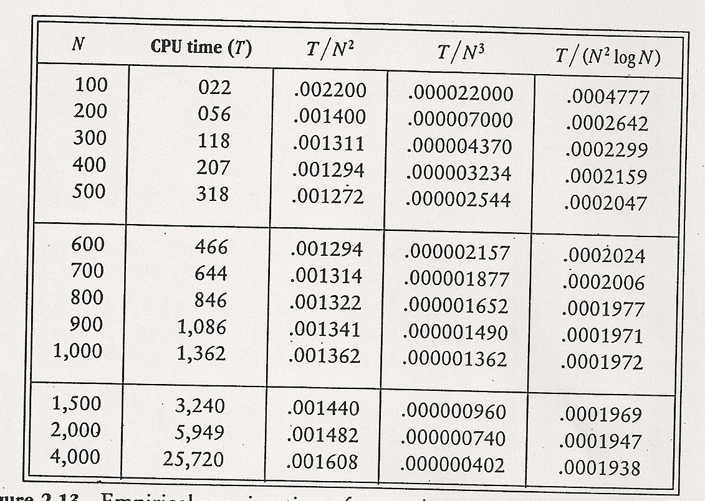

Slide 15
In the example
T = Θ(n².logn)

